Slide 1
Unit 1. Computing Environments
1.7 Programming Languages
Machine Code
Assembly Language and Assembler
Source Code and Object Code
Translator, Assembler, Compiler, Interpreter
Pros and cons of compilers and interpreters
Program debugging: Syntax errors vs. Semantic errors

Slide 2
Machine Code
The only programming language that a CPU can use is machine code.
Every different type of computer/chip has its own set of machine code Instructions. Each machine code instruction performs one simple task, for example, storing a value in a memory location at a specified address.
A computer program stored in main memory is a series of machine code instructions that the CPU can automatically carry out.
Machine code is binary, it is sometimes displayed on a screen as hexadecimal so that human programmers can understand machine code instructions more easily.
Writing programs in machine code is a specialised task that is very time consuming and often error prone, as the only way to test a program written in machine code is to run it and see what happens.

Slide 3
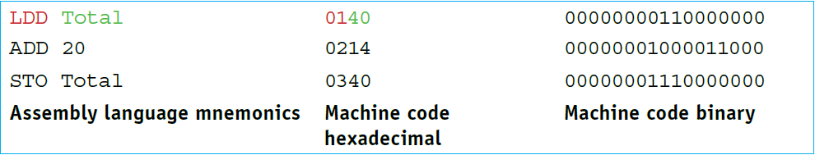
Assembly Language
In order to shorten the development time for writing computer programs, other programming languages were developed. The first programming language to be developed was assembly language, this is closely related to machine code and uses mnemonics instead of binary.

Slide 4
Assembler
Source code – a computer program before translation into machine code.
Object code – a computer program after translation into machine code.
Assembler – a computer program that translates programming code written in assembly language into machine code.

Slide 5
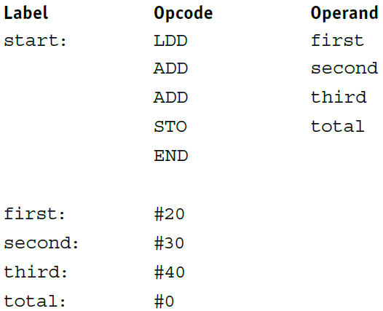
Higher-level Language v.s Assembly Language
In a high-level language, adding three numbers together and storing the answer would typically be written as a single instruction:
The same task written in assembly language could look like this:

Slide 6
How are higher-level language programs executed?
Translator – the systems software used to translate a source program written in any language other than machine code. There are three types of translator: assembler, compiler, interpreter.
Compiler – a computer program that translates a source program written in a high-level language to machine code, object code. Compilers usually store the translated program (object program) on a storage medium ready to be executed later. A loader program is needed to load the stored translated program into main memory before it can be executed. The stored translated program can be executed many times without being retranslated. The program will only need to be retranslated when changes are made to the source code.
Interpreter – computer program that analyses and executes a program written in a high-level language line by line. With an interpreter, no translated program is generated in main memory or stored for later use. Every line in a program is interpreted then executed each time the program is run.

Slide 7
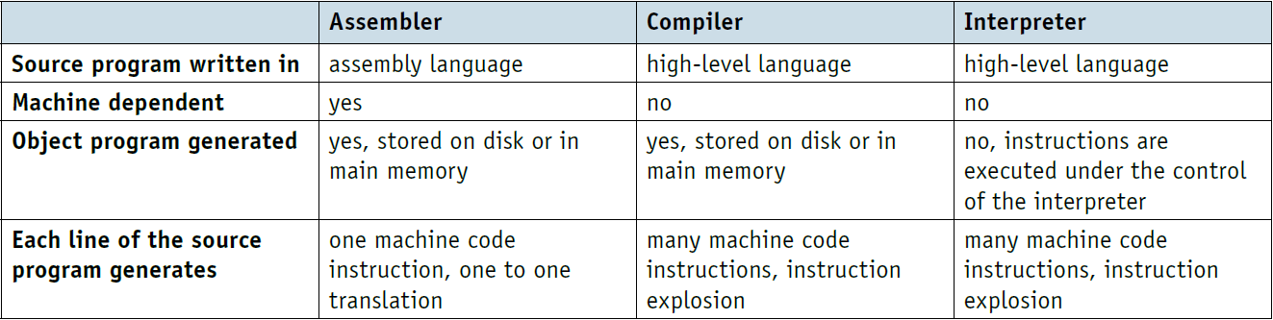
Similarities and differences between assemblers, compilers and interpreters

Slide 8
Source Code, Compiler and CPU
https://www.youtube.com/watch?v=QXjU9qTsYCc

Slide 9
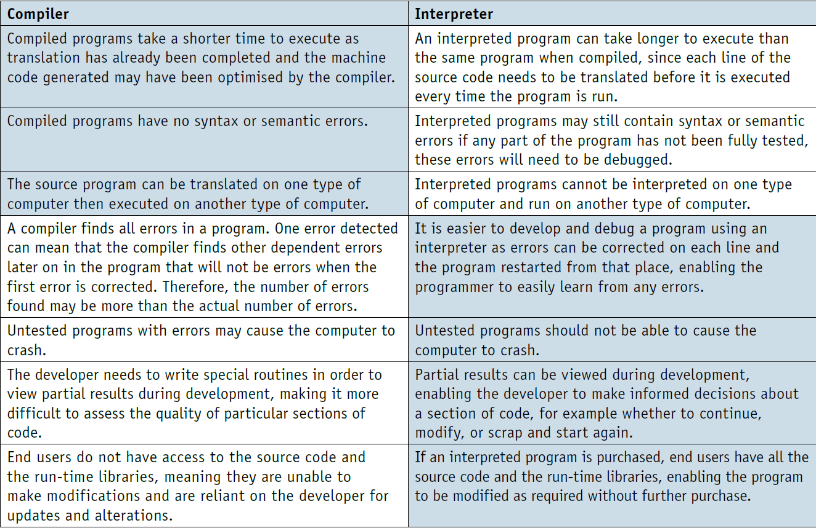
Pros and Cons of Compilers and Interpreters

Slide 10
Program Debugging
Program debugging is the process of finding and correcting errors ( “bugs” ) in a computer program.
Syntax errors are caused by invalid syntax (for example, entering prnt instead of print). Since a translator cannot understand instructions containing syntax errors, translators terminate when encountering such errors indicating where in the program the problem occurred.
Semantic errors (generally called logic errors ) are errors in program logic. Such errors cannot be automatically detected, since translators cannot understand the intent of a given computation.

Slide 11
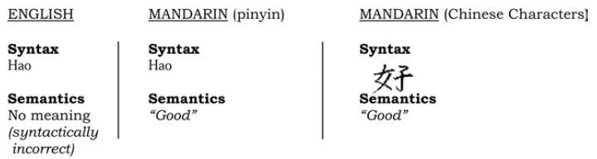
Syntax vs. Semantics
The syntax of a language is a set of characters and the acceptable sequences of those characters.
The semantics of a language is the meaning associated with each syntactically correct sequence of characters.
“Colorless green ideas sleep furiously.”
This sentence is syntactically correct, but is semantically incorrect, and thus has no meaning.
“Hello there, how are you?” – Syntactically correct
“Hello there, hao are you?” – Syntactically incorrect

Slide 12
Procedural vs. Object-Oriented Programming
Procedural programming is a programming paradigm built around the idea that programs are sequences of instructions to be executed. They focus heavily on splitting up programs into named sets of instructions called procedures, analogous to functions.
Object-oriented programming (OOP) is a programming paradigm based on the concept of "objects", which can contain data and code: data in the form of fields (often known as attributes or properties), and code, in the form of procedures (often known as methods).

Slide 13
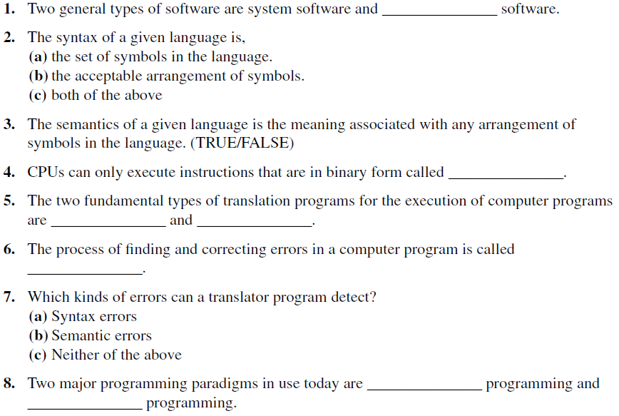
Practice Questions

